Slide 1
Unit 1
Where did you go on vacation?
Section B（3a-4)

Slide 2
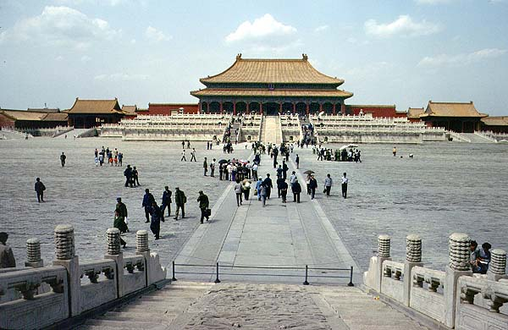
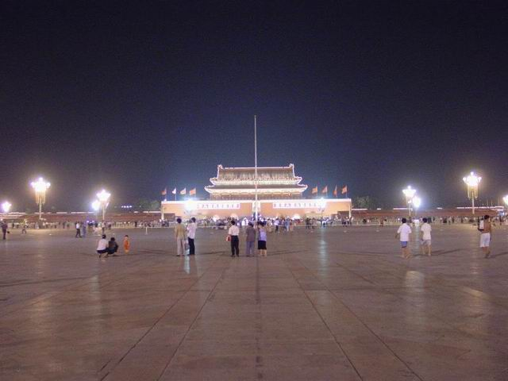
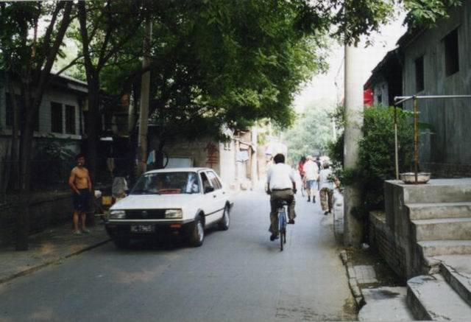
Task 1：Complete the diary entry about a trip to one of these places. Use the words and phrases in the box to help you.
the Palace Museum
Tian’an Men Square
a Beijing Hutong
hot and sunny tired happy
Beijing duck delicious
take some photos beautiful
buy something special interesting
learn something important August

Slide 3
Wednesday , ________ 20th
Today the weather was ______________.
I went to _______________. It
was .We_________________
_______________________. I liked this place
because _____________________ .
For dinner we had _____________ . It was
_______.
In the evening , I felt really _____.
August
hot and sunny
Tian’anmen Square
beautiful
took some photos
and bought something special
I learned something important
Beijing duck
delicious
tired

Slide 4
Task 2： Brainstorm (more words about a trip)
Food:
Weather:
Places:
Trip
Feelings:
Activities:
People:

Slide 5
Task 3: Pairwork
Imagine you were all foreigners on vacation in China. You met each other at the airport on your way home. Work in pairs to talk about your vacation.

Slide 6
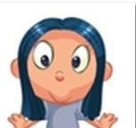
Hi, Paul. I’m Anna. Where did you go on vacation?
Hi, my name’s Paul.
I went to Qingdao.
Oh, I went to Beijing. Did you do anything special in Qingdao?
Well, I went to the museum.

Slide 7
Oh, Paul. Did you go with anyone?
I went there with my friend.
How was the weather?
The weather was sunny.

Slide 8
What did you do every day?
I took quite a few photos every day.
I ate some seafood.
What food did you eat?

Slide 9
What did you like best?
I like the beach best.
How did you feel about the trip?
I liked the trip so much.

Slide 10
Tips: The following questions may help you. Please answer the questions with complete sentences to make notes about a vacation you took.
1.Where did you go on vacation?
2.Did you go with anyone?
3. How was the weather?
4. What did you do every day?
5.What food did you eat?
6.What did you like best?
7. How did you feel about the trip?
Hi, my name’s Paul.
Hi, Paul. I’m Anna. Where did you go on vacation?
I went to Qingdao.
Well, I went to the museum.
Oh, I went to Beijing. Did you do anything special in Qingdao?

Slide 11
1.Where did you go on vacation?
I went to Qingdao on vacation.
Did you go with anyone?
(Yes, I did.) I went there with my friend.
3. How was the weather?
The weather was sunny.
4. What did you do every day?
I took quite a few photos every day.
5.What food did you eat?
I ate some seafood.
6.What did you like best?
I like the beach best.
7. How did you feel about the trip?
I liked the trip so much.

Slide 12
Task 4： Pefect the diary entry.
Thursday, August 1st
Today I went to Qingdao. I went there with my friend. It was sunny and hot. Then we went to the beach. There were many people there. Some were playing beach volleyball.

Slide 13
Some were swimming. They were all happy. I took a lot of photos. For lunch, we tried some seafood. It was really delicious. In the afternoon, we visited a museum. The things there were very interesting. We got back late, we were tired but happy. What a fun trip!

Slide 14
Show time :
Share your diary entry with us!

Slide 15
Homework
《安》P8
《周》Unit 1第3版

Slide 16
Self Check
1. Complete the conversations with the correct words in the box.
anything, everything, nothing, anyone, everyone, no one
1. A: Did ______ go on vacation with
you last month?
B: Yes, my family went to the
countryside with me.
anyone

Slide 17
2. A: Did your family go to the beach with
you last weekend?
B: No. _______ from my family went,
but my friend went with me.
No one
3. A: I didn’t bring back anything from
Malaysia.
B: ________ at all? Why not?
Nothing

Slide 18
4. A: Did you buy ________ in the shopping
center?
B: No, I didn’t. ___________ was very
expensive.
5. A: How was the volleyball game yesterday?
B: Great! _________ had a fun time!
anything
Everything
Everyone

Slide 19
2. Complete the passage with the
correct forms of the verbs in the
brackets.

Slide 20
Last August, our class ___ (do) something very special on our school trip. We _____ (go) to Mount Tai. We ______ (start) our trip at 12:00 at night. Everyone in our class ____ (take) a bag with some food and water. After three hours, someone looked at the map and _____ (find) out we _______ (be, not) anywhere near the top.
did
went
started
took
found
weren’t

Slide 21
My legs ____ (be) so tired that I wanted to stop. My classmates ____ (tell) me to keep going, so I _____ (go) on. At 5:00 a.m., we got to the top! Everyone _______ (jump) up and down in excitement. Twenty minutes later, the sun _______ (start) to come up. It was so beautiful that we ______ (forget) about the last five hours!
were
told
went
jumped
started
forgot

